Slide 1
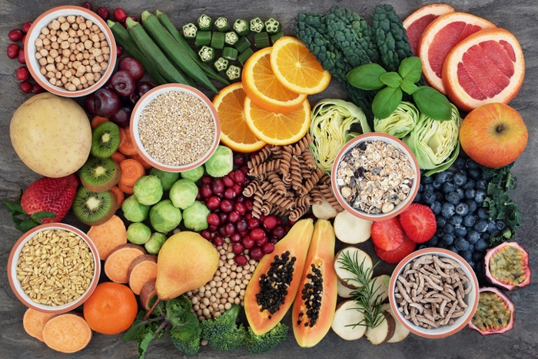
Meal planning

Slide 2
Definitions
Food- Food is the material consisting essentially of protein, carbohydrates and fat used in the body of an organism to sustain growth, repair and vital processes and to furnish energy; and also such material together with supplementary substances(as minerals, vitamins and condiments)
Nutrition- Nutrition is the process by which body utilizes food for growth and maintenance and healthy living. It is a science of food and its relationship to health and concerned with the part played by food factor (nutrients) in body growth, development and maintenance.
Objective of nutrition-
1. To promote physical and mental growth and development of human beings.
2. Building and repairing of tissues and cell damaged by infection and injuries.
3. To provide energy for doing works.
4. To protect the human beings from infections and deficiency disorders.

Slide 3
Contd.
Health – Health is a state of physical, mental and social well being and not merely the absence of disease or infirmity- by WHO
Balanced diet – A balance diet means getting the right types and amounts of foods and drinks to supply nutrition and energy for maintaining body cells, tissues and organs and for supporting normal growth and development.

Slide 4
Types of Nutrition
Optimum Nutrition- It can be defined as eating the right amounts of nutrients on a proper schedule to achieve the best performance and the longest possible lifetime in good health assuming that external negative influences like accidents and infectious diseases can be avoided.
Over Nutrition- Over nutrition is frequent or habitual over consumption of nutrients by eating too much food to the point that it becomes dangerous to health.
Under Nutrition- Under nutrition is the opposite of over nutrition, meaning that it is a nutrient deficiency from not eating enough food.
Mal Nutrition- Malnutrition is a broad term which refers to both under nutrition and over nutrition. Individuals are malnourished , or suffer from under nutrition if their diet does not provide them with adequate calories and protein for maintenance and growth or they can not fully utilize the food they eat due to illness.

Slide 5
Meal Planning
Meal planning or Menu planning is defined as a simple process which involves application of knowledge of food, nutrients, food habits and likes and dislikes to plan wholesome and attractive meals.

Slide 6

Meal planning
Meal planning It is a process of deciding what we should eat each day at each meal.
It is making a plan of meals with adequate nutrition for every member within available resources.

Slide 7
Aims of meal planning
It should meet the nutritional requirements of individual.
Meal planning should provide maximum nutrients.
Consideration of individual’s likes and dislikes.
Meal planning should provide variety.
Economic consideration should be there.
Food habits and seasonal availability should be taken care of.
Psychological aspect should be there.
To serve attractive and appetizing meal.

Slide 8
Objectives of meal planning
In planning meals aim is :
To satisfy the nutritional needs of the family members, according to their age and occupation.
Keep expenditure within your family's food budget.
To decide amounts of foods to be purchased from each food group.

Slide 9
cont…
4. To consider family size and composition.
5. To consider food storage space and conditions of storage, to decide how often you need to purchase various foods.
6. Prepare a food purchase list, taking the food preferences of members into account.
7. Use methods of preparation, which retain nutrient, without sacrificing palatability (taste).

Slide 10
8. Serve meals, which are appetizing and attractive and fit in the schedule of the members.
9. Manage the time, energy and available materials efficiently, with help of the family members
you make a weekly plan for all meals, you can save time, energy and money.

Slide 11
Factors affecting meal planning
Nutritional adequacy- Meal pattern must fulfill the nutritional requirements of individual in the family. As nutritional requirements vary from person to person acc. to age, gender, physical activity and psychological state so due consideration should be given.
Economy- A major part of income is spent on food so socio-economic status should be considered while meal planning. It is very important to know the less expensive alternatives for the more expensive recommended foods having, high nutritive value.
Satiety value- Any individual meal should provide enough satiety value so that one doesn’t feel hungry till its time for the next meal. Proteins and fats have greater satiety value as compared to carbohydrates e.g. a breakfast of tea and toast will not provide enough satiety value till lunch whereas the breakfast of milk, cereal, eggs and fruit will provide enough satiety value till lunch.

Slide 12
Contd.
Personal likes and dislikes- Although the RDA for each class of food should be followed there is room for individual preference among each food class. Some people make personal likes and dislikes the only basis for the inclusion or exclusion of certain foods in their meals- failure to include milk is a common practice. It is always better to change the form of food rather than to completely omit it. For example-milk can be given in form of curd, cheese, custard or other sweet dish, soybean in the form of soya flour chapattis mixed with wheat flour.
Availability of food stuffs and climate- In earlier times the dietary food habits depended upon the foods produced in a particular area or locality, but nowadays with improved methods of food preservation & distribution, even the most perishable foods are available over large areas. The wide variation in dietary patterns throughout the world depends largely upon the available food supply and which depends on the climate. Thereby, only seasonal foods should be included in the diet. Also, the season of the year requires some considerations for the type of dishes selected e.g. inclusion of hot soups etc. in cold winter days & chilly salads juices in summers.

Slide 13
Contd.
Religion, traditions & customs- They are important in determining the food included in diet , type of meal and the dishes served to individual of a family. Foe instance, Muslims don’t eat pork, whereas Hindus don’t eat beef. Rice is considered an auspicious dish in festivals and marriages. Widows are generally not served fish in Bengal. Therefore, religion, tradition & customs should be kept in view while planning meals for a family.
Variety- It is very important because nobody likes to eat even his favourite food stuff repeatedly. Therefore, to introduce variety, do not repeat same food items during day meal. Also variety in meal planning is the sum total of all kinds & classes of food served in pleasing color combinations, with judicious mixture of soft and crisp foods, blunt and sharp flavors, hot and cold dishes. It ensures better nutrition and also result in more interesting meals with an attractive variety of texture, color, taste and appearance which in turn stimulates appetite and please the palate. Various methods of working can also introduce a variety- a meal consisting of tandoori roti, dal and seasonal green vegetable also with a crisp salad.

Slide 14
Contd.
Occasion- For daily meals the first importance is given to nutritive value. For special occasions, special importance is given to color, appearance, number of dishes to be included, but at the same time nutritive value can not be ignored. Similarly each festival has its specific food item which should always be given importance e.g. preparing sweets for Deepawali, cake for Christmas etc.
Schedules of family members: When planning meals, one needs to think of the schedules (time table) of the family members – meal times and the number of meals eaten at home and those that are eaten away from home. If packed lunches are made, the menus need to be modified to ensure that the items can be packed and the menu is appetizing even when cold.

Slide 15
Contd.
Family size and composition: The family size affects the foods that can be served. It is known that the money spent for food per person decreases as the family size increases, when the family income remains constant. Staples such as wheat and rice are bought in larger amounts but quantity of milk, vegetables and fruits is lowered. Thus, the quality of the diet is affected. Family composition affects the kind and amounts of food needed and pattern of meals served. For eg. when children are below 5 years of age, more milk is required, the numbers of meals are more, as the child cannot take large amount at a time. As the child grows the meal pattern changes to accommodate the school hours and the need to pack lunch or snack may arise. Older members of the family may require change in consistency of food due to faulty teeth.
Meal Times: It is also an important factor in meal planning. The meals should be planned according to the time for meal i.e. whether it is breakfast, lunch or dinner. Normally while planning the meal for whole day, it is seen that 1/3rd of day’s requirement are met by lunch 1/3rd by dinner and 1/3rd by breakfast and evening tea. But this is not a rigid schedule and can be changed according to individual requirement.

Slide 16
Steps in meal planning
Four steps involved in meal planning
Planning
Purchasing
Preparation
Serving
Notes:
start

Slide 17
1. Planning
Meal planning can be done by the family as a joint project.
The Family members can discuss the meal plans, the food budget and actual preparation and help in making the plans work. Such co-operation will lead to greater acceptance and enjoyment of the meal.
Each day we eat three meals and an additional snack.

Slide 18
Cont…
The various members of the family partake of these meals. We plan the meals to ensure that the each family member are met.
The plan can be flexible to take advantage of lower prices of seasonal foods, and to meet needs and choices of family.
Notes:
Partake: eat or drink (something).

Slide 19
2. Purchasing
Make budgeting and shopping strategies to Meal Management
Prepare a shopping list - group similar foods together to be efficient
Check cupboards/pantry to avoid duplication familiarize yourself with the store layout
Comparison shopping - compare unit prices and cost per serving

Slide 20
Avoid damaged goods and frozen packages with ice crystals on outside
Check dates on the package
Plan meals around store specials
Avoid shopping when hungry or tired
Limit shopping trips - the more trips to the store the more money spent
Buy foods in season for best prices and quality
using a calculator while shopping can help keep track of money spent while shopping

Slide 21
3. Preparation
The circumstances, values, and ways families manage their resources from house to house are very different in terms of meal preparation.
Family Size: This affects the amount of money needed, the preparation time, and the style of table service preferred.
Age: Babies, children, teenagers and parents need different foods and don’t eat the same amount

Slide 22
Activity Level: With more exercise, the body requires more energy.
Food Preferences: All families don’t like the same kinds of foods because of culture and traditions.
Time: Recipes vary greatly in preparation time required. When there is little time, fix foods requiring little time.
Special Diets: Health considerations such as diabetes, high blood pressure, lactose intolerance, ulcer, stroke, and heart problems influence what people eat.

Slide 23
4.Serving
Serve a balance of family favorites and new recipes
Don’t serve a food twice in the same day
Liquid food :usually served before the main course or at times, together with the main course Ex: soup (veg or meat)
Cold dish: consisting of a mixture of food served with a dressing Ex: fruit salad, vegetable salad
Appetizer: Small dish of food served at the beginning of the meal to stimulate the appetite Ex: spicy bread rolls

Slide 24
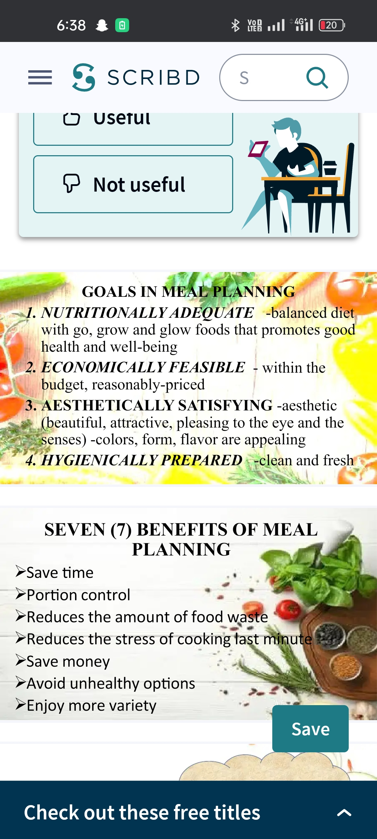

Slide 25


